Slide 1
MolLVAE: de novo drug design with hierarchical latent representation
Team members: Weixin Xie, Jiahui Liu
Code: https://github.com/wxx07/MolLVAE

Slide 2
Introduction
Hierarchical description of molecules
Side chain
Bemis-Murcko scaffold, 1996
Other scaffold or hierarchy
Linker
Framework
Thioridazine
Ring system
Bemis, Guy W., and Mark A. Murcko. Journal of medicinal chemistry 39.15 (1996): 2887-2893.
Notes:
例子：硫利达嗪

Slide 3
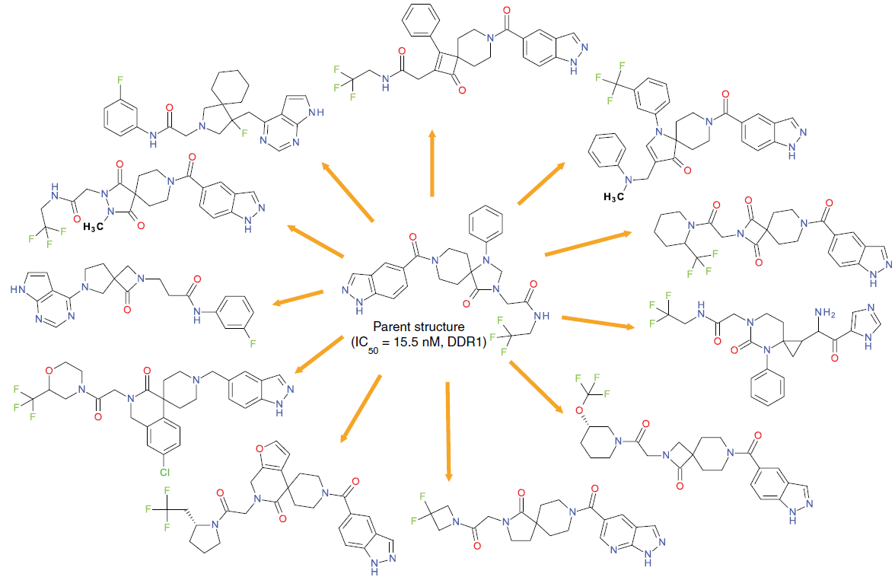
Introduction
Why is hierarchical representation needed?
Multi-object optimization
Binding affinity
Potency
Selectivity
Physicochemical
and ADMET properties
…
Side chain modification
or scaffold hopping
Zhavoronkov, Alex, et al. Nature biotechnology 37.9 (2019): 1038-1040.
Notes:
从高通量筛选得到的先导化合物（起始小分子）或者已有的药物分子出发，可能具有不太好的物理化学和药物动力学性质，有时对侧链的修改，能够改善，但有时候需要在原骨架的基础上进行调整（骨架跃迁）
所以自然希望在设计的时候，能够对各个层次的结构进行变化，来适应不同的实际需要
分子优化是多目标优化任务，依据实际的需要，有时需要对侧链进行改动，有时候需要进行骨架跃迁。所以用深度生成模型进行de novo设计，自然是希望能够获得分子在不同层次的表示，能够进行灵活又有目的性地改动

Slide 4
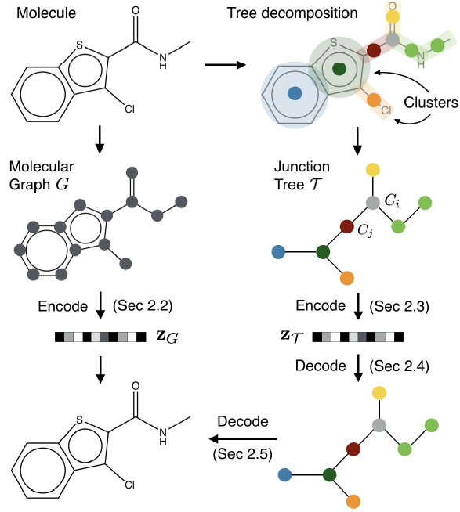
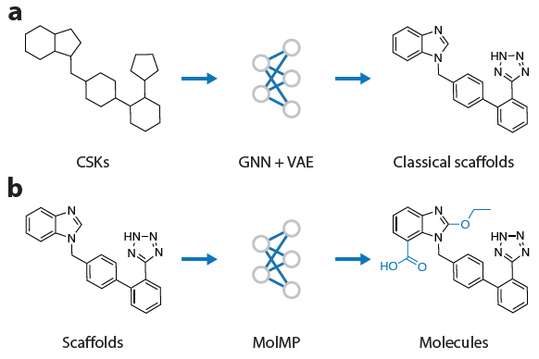
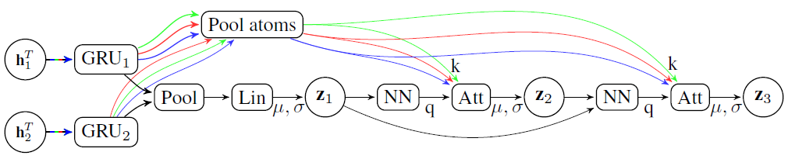
Related work
Li, Yibo, et al. Journal of Chemical Information and Modeling (2019).
Jin, Wengong, et al. arXiv preprint arXiv:1802.04364 (2018).
Alperstein, Zaccary, et al. arXiv preprint arXiv:1905.13343 (2019).
Lack of hierarchical representation for molecule
Notes:
JTVAE 和 deepscaffold，生成过程是一个分子图的层级生成过程，但并没有能够获取一个控制不同层次的表示，而all smile VAE用到了自回归的隐变量表示，但没有讨论对于分子生成的影响。

Slide 5
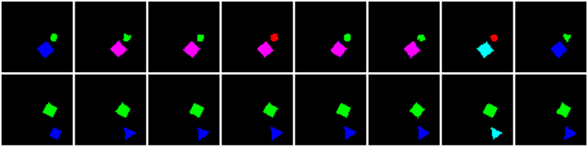
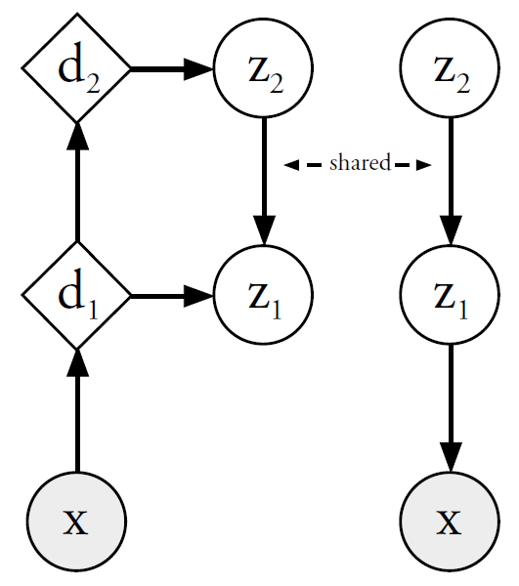
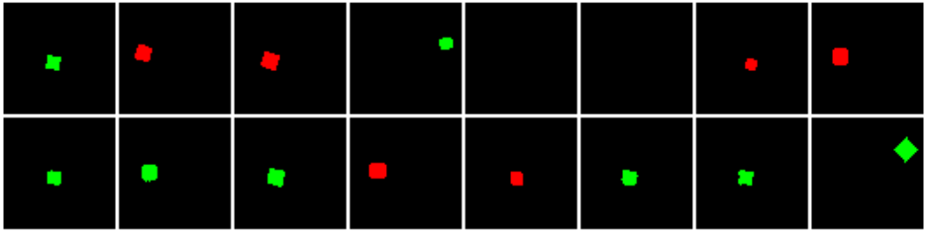
Related work
Adapt ladder VAE for molecular generation
Layer 3
Layer 12
Multi-dSprites
Sønderby, Casper Kaae, et al. NIPS 2016.
https://github.com/addtt/ladder-vae-pytorch
Notes:
希望学到一个有层级区分的隐变量表示，实现分子生成在不同层次上的控制

Slide 6
Dataset
SMILES form: ChEMBL dataset (compounds with bioactivity)
Preprocessing
Standardization: removal of salt and isotopes, charge neutralization
and remove stereochemistry information
Remove compounds with elements outside {H, C, N, O, F, P, S, Cl, Br, I}
Canonicalization
Remove QED(quantitative estimate of drug-likeness) < 0.5
train : valid : test = 891329 : 111416 : 111417 ~ 8:1:1
Vocabulary size: 37 (with <bos>, <eos>, <pad> and <unk>)

Slide 7

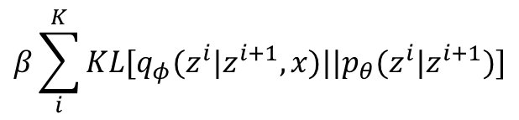
Method
Overview of MolLVAE
2
Sønderby, Casper Kaae, et al. NIPS 2016.
LVAE
LOSS
d₃
z₃
z₃
shared
$$β\sum_{i}^{K}{KL[q_{φ}(z^{i}|z^{i+1},x)||p_{θ}(z^{i}|z^{i+1})]}$$
d₂
z₂
z₂
shared
+
$$L_{recon}(mol,m\hat{o}l )$$
d₁
z₁
z₁
cross entropy loss
bidirectional LSTM
reconstructed molecule
molecule
LSTM
Encoder
Decoder

Slide 8
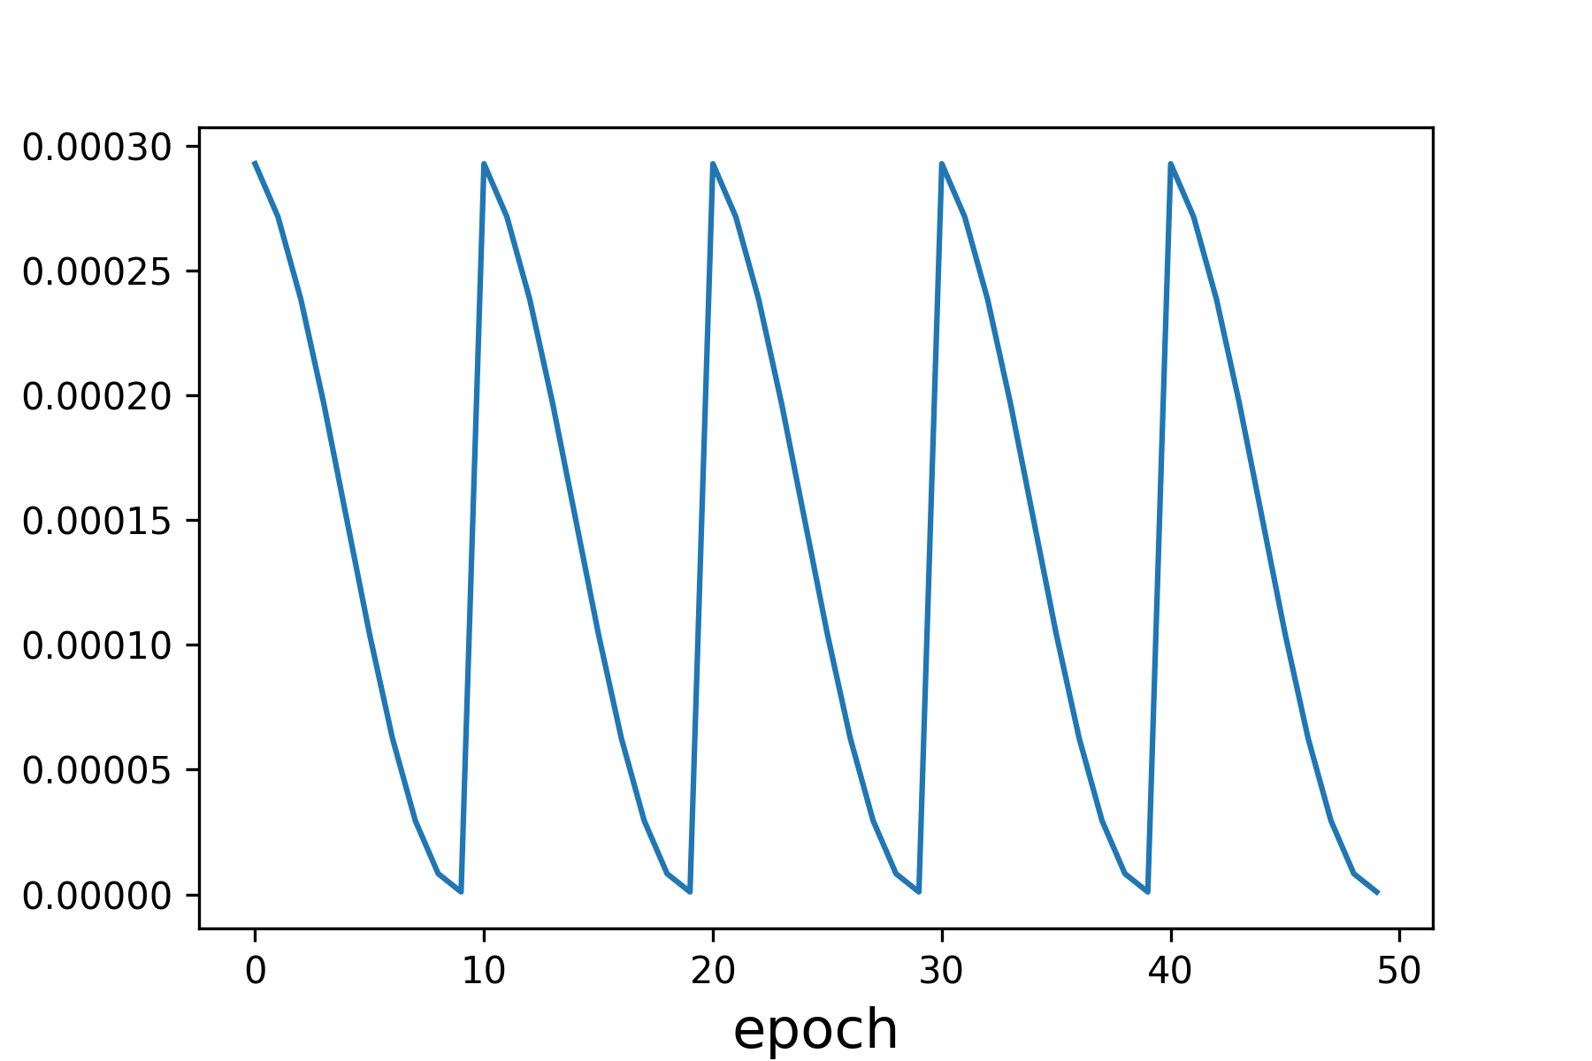
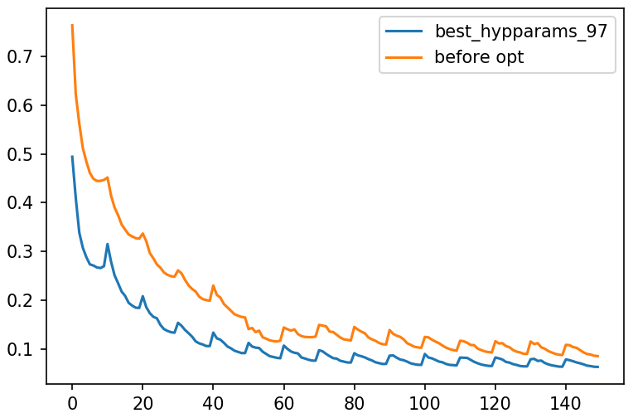
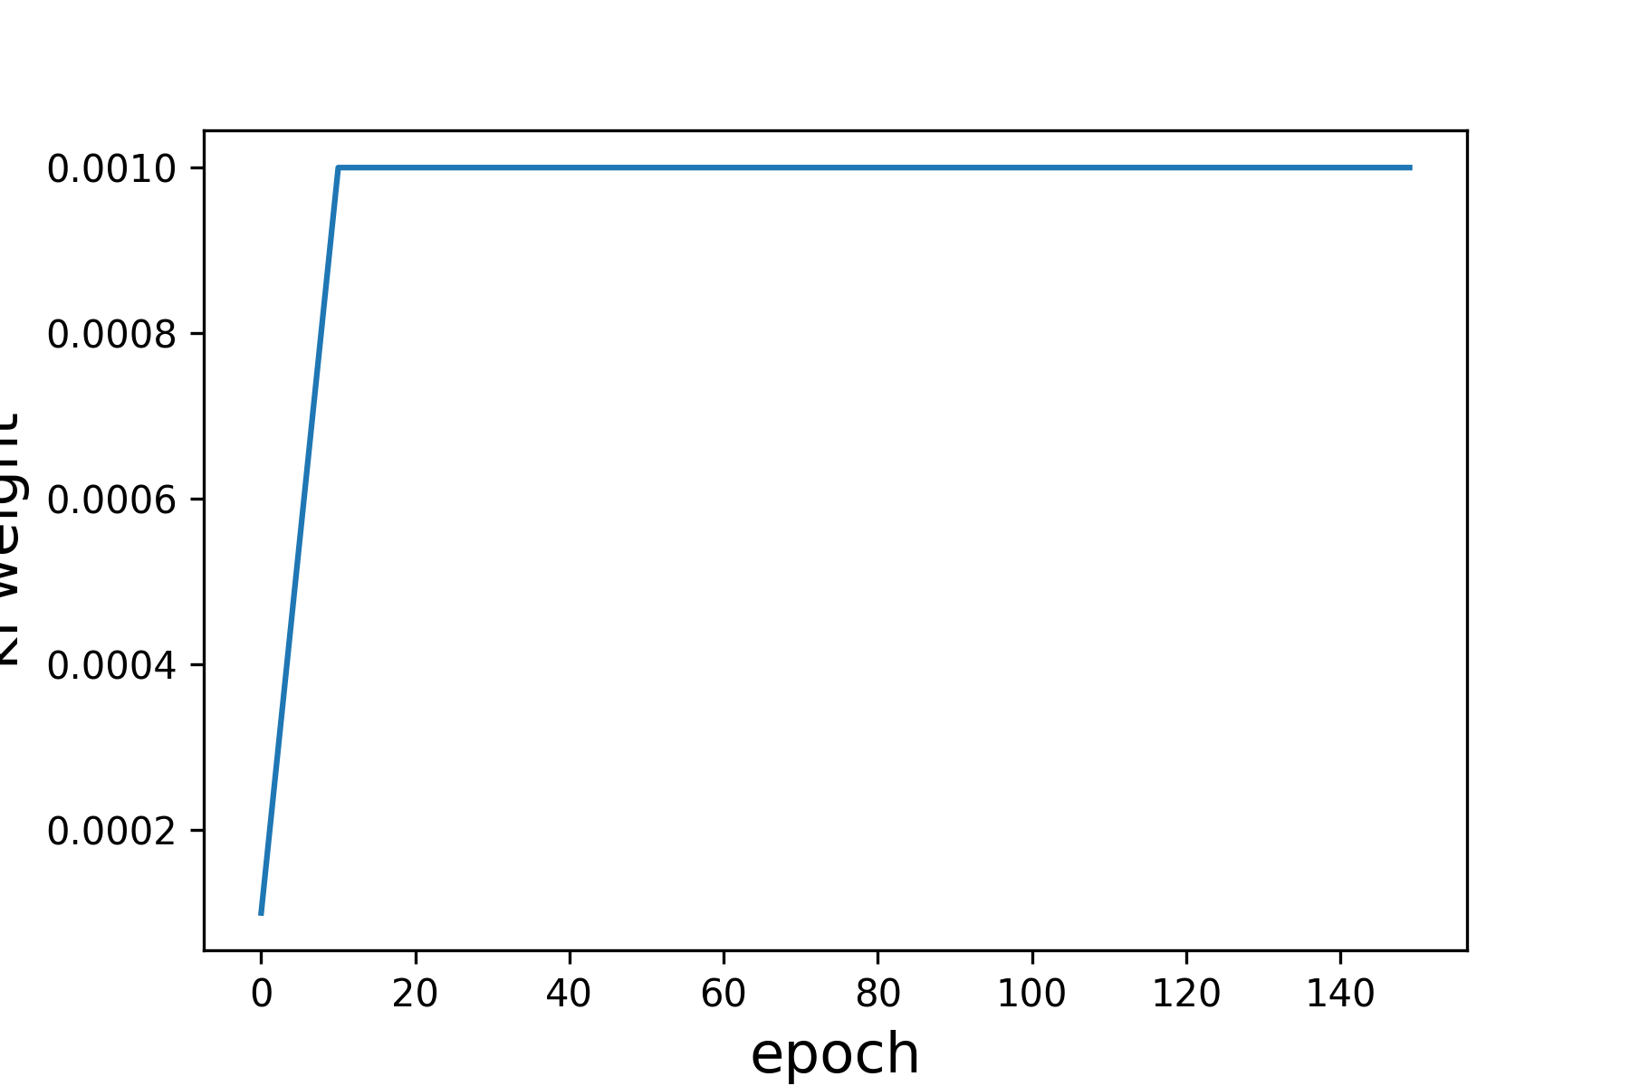
Method
Training details
Learning rate annealer：cosine annealing with restart
10 epoch / period, 3e-4 → 1e-6
KL loss weight annealer
1e-4 → 1e-3
Hyperparameters searching: random searching
100 combinations
Compare eval loss at the end of first epoch
lr
epoch
eval loss
KL weight
epoch
epoch

Slide 9
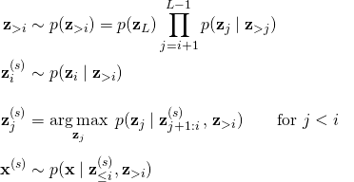
Method
Sample
…
…
z₃
1000
10
z₃
…
…
…
Sample from prior distribution
…
z₂
100
z₂
1000
…
…
…
…
…
z₁
1000
z₁
1000
Hierarchical control experiment
…
z₃
z₂
z₁
https://github.com/addtt/ladder-vae-pytorch
Notes:
采样的过程中保证只有z2的随机性

Slide 10
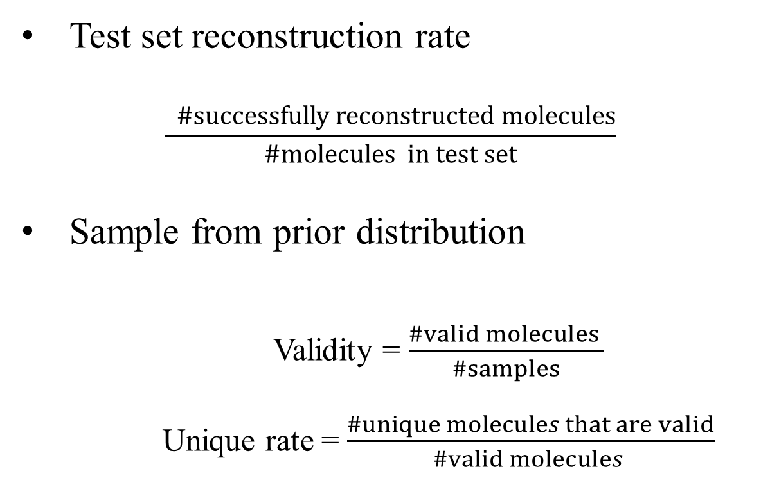
Method
Eval metric
Test set reconstruction rate
$$\frac{ \#successfully reconstructed molecules}{\#molecules in test set}$$
Sample from prior distribution
Validity = $\frac{\#valid molecules }{\#samples}$
Unique rate = $\frac{\#unique molecules that are valid}{\#valid molecules }$

Slide 11
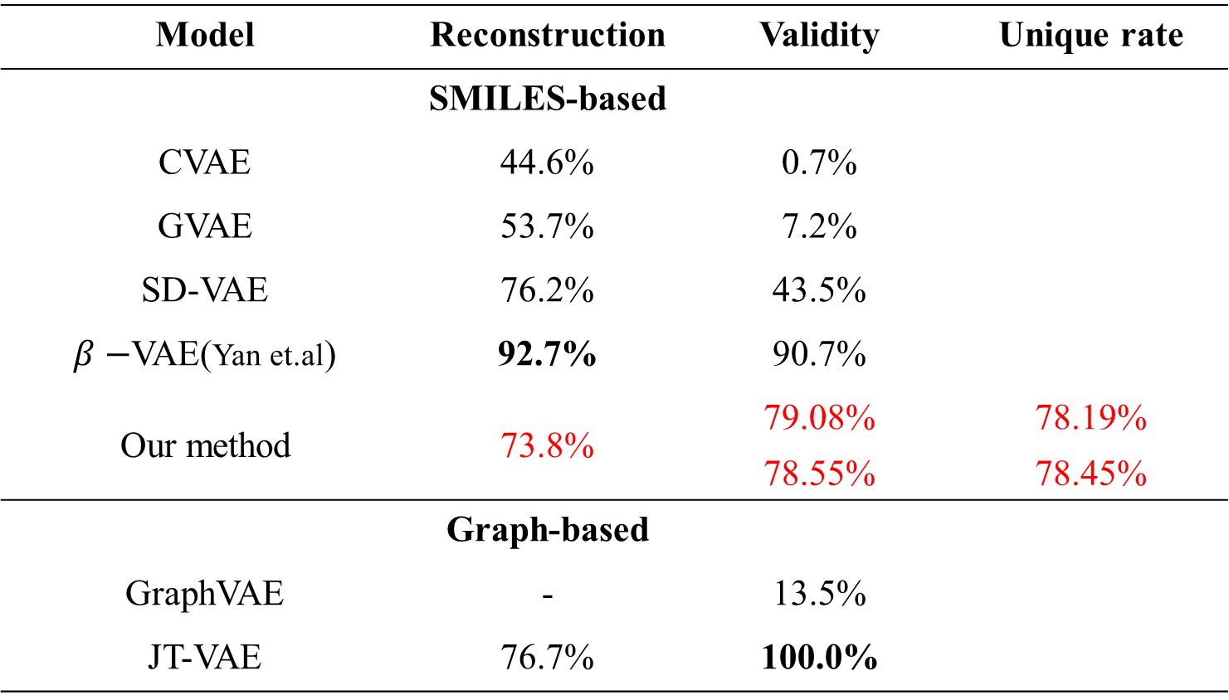
Results
Reconstruction /Validity/Unique rate
Model | Reconstruction | Validity | Unique rate
 | SMILES-based
CVAE | 44.6% | 0.7%
GVAE | 53.7% | 7.2%
SD-VAE | 76.2% | 43.5%
$β−$VAE(Yan et.al) | 92.7% | 90.7%
Our method | 73.8% | 79.08% | 78.19%
 |  | 78.55% | 78.45%
 | Graph-based
GraphVAE | - | 13.5%
JT-VAE | 76.7% | 100.0%
Sample top z 1000 times from prior distribution and decode each mol 10 times
Sample z 10 times at each level and decode each mol 10 times

Slide 12
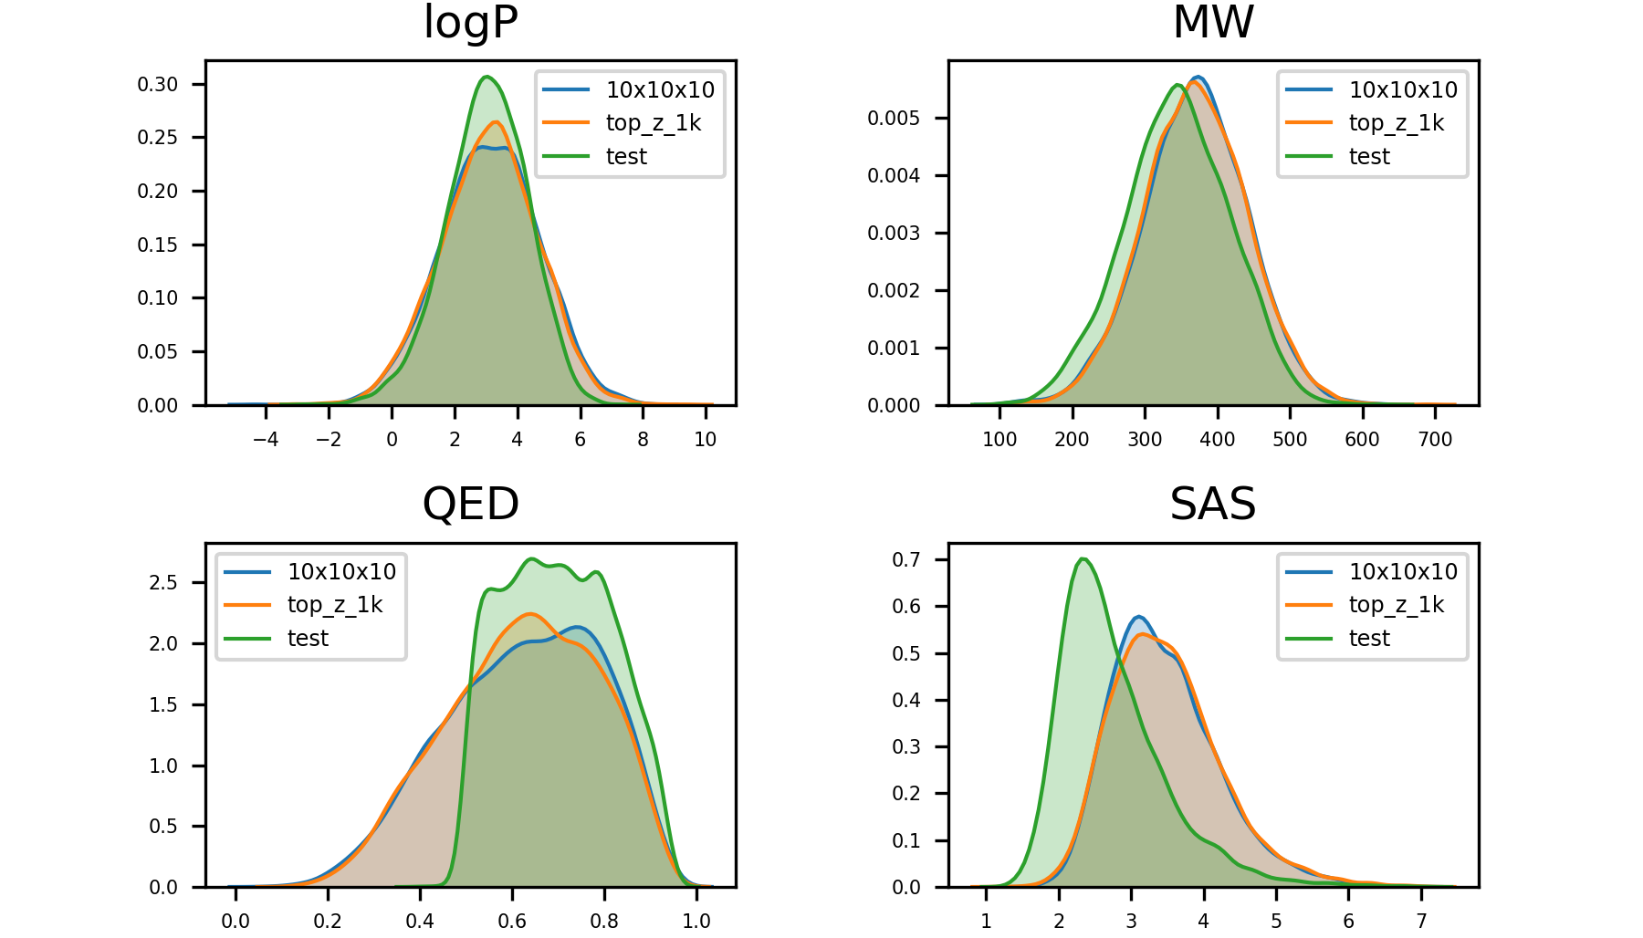
Results
Comparation of molecular properties

Slide 13
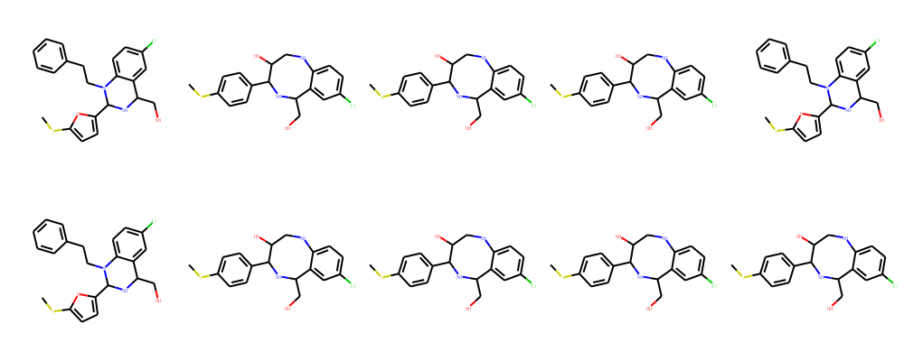
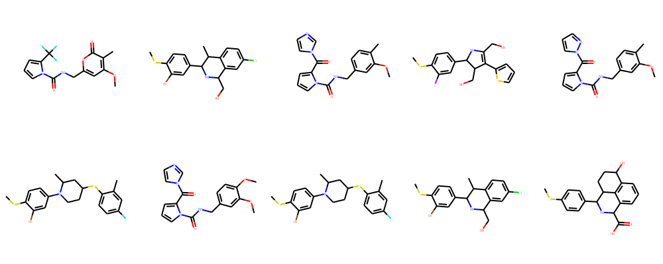
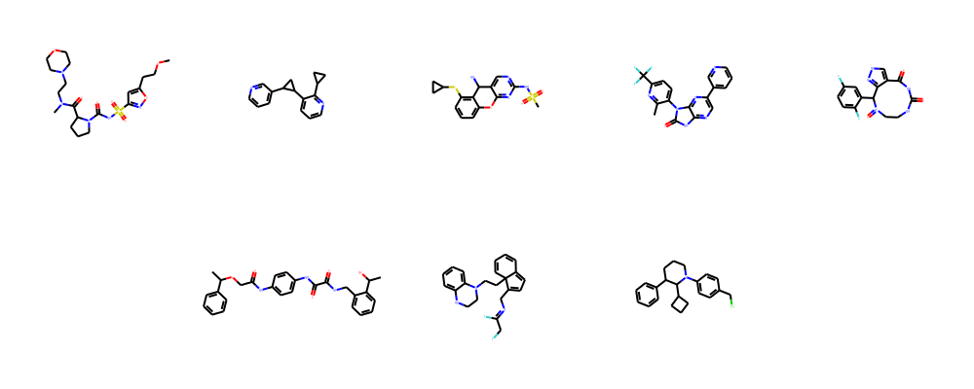
Results
Hierarchical control experiment
Sampled z layer
Unique BM-scaffold rate
Molecule visualize
z₃
0.3%
z₂
4.5%
z₁
94.9%
Notes:
骨架

Slide 14
Conclusion
Achieved regular performance on test set reconstruction rate, validity and unique rate.
Observed different effects on molecular generation for each z layer.
Future plans:
Take graph as input;
Batch normalization;
Deep ladder;
…

Slide 15
Q&A

